Slide 1



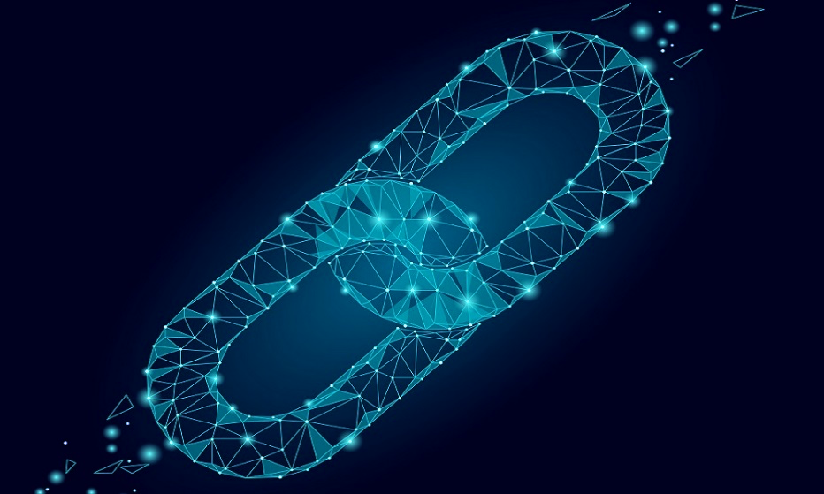
CCIS
Cloud Computing and Intelligence Systems
Digital Resource Rights Confirmation and
Infringement Tracking Based on Smart Contracts
Peng Qian†, Zhenguang Liu†, Xun Wang†, Jianhai Chen*, Bei Wang*, Roger Zimmermann$ξ$
† School of Computer and Information Engineering, Zhejiang Gongshang University
* School of Computer Science and Technology, Zhejiang University
$ξ$ School of Computing, National University of Singapore
messi.qp711@gmail.com

Slide 2
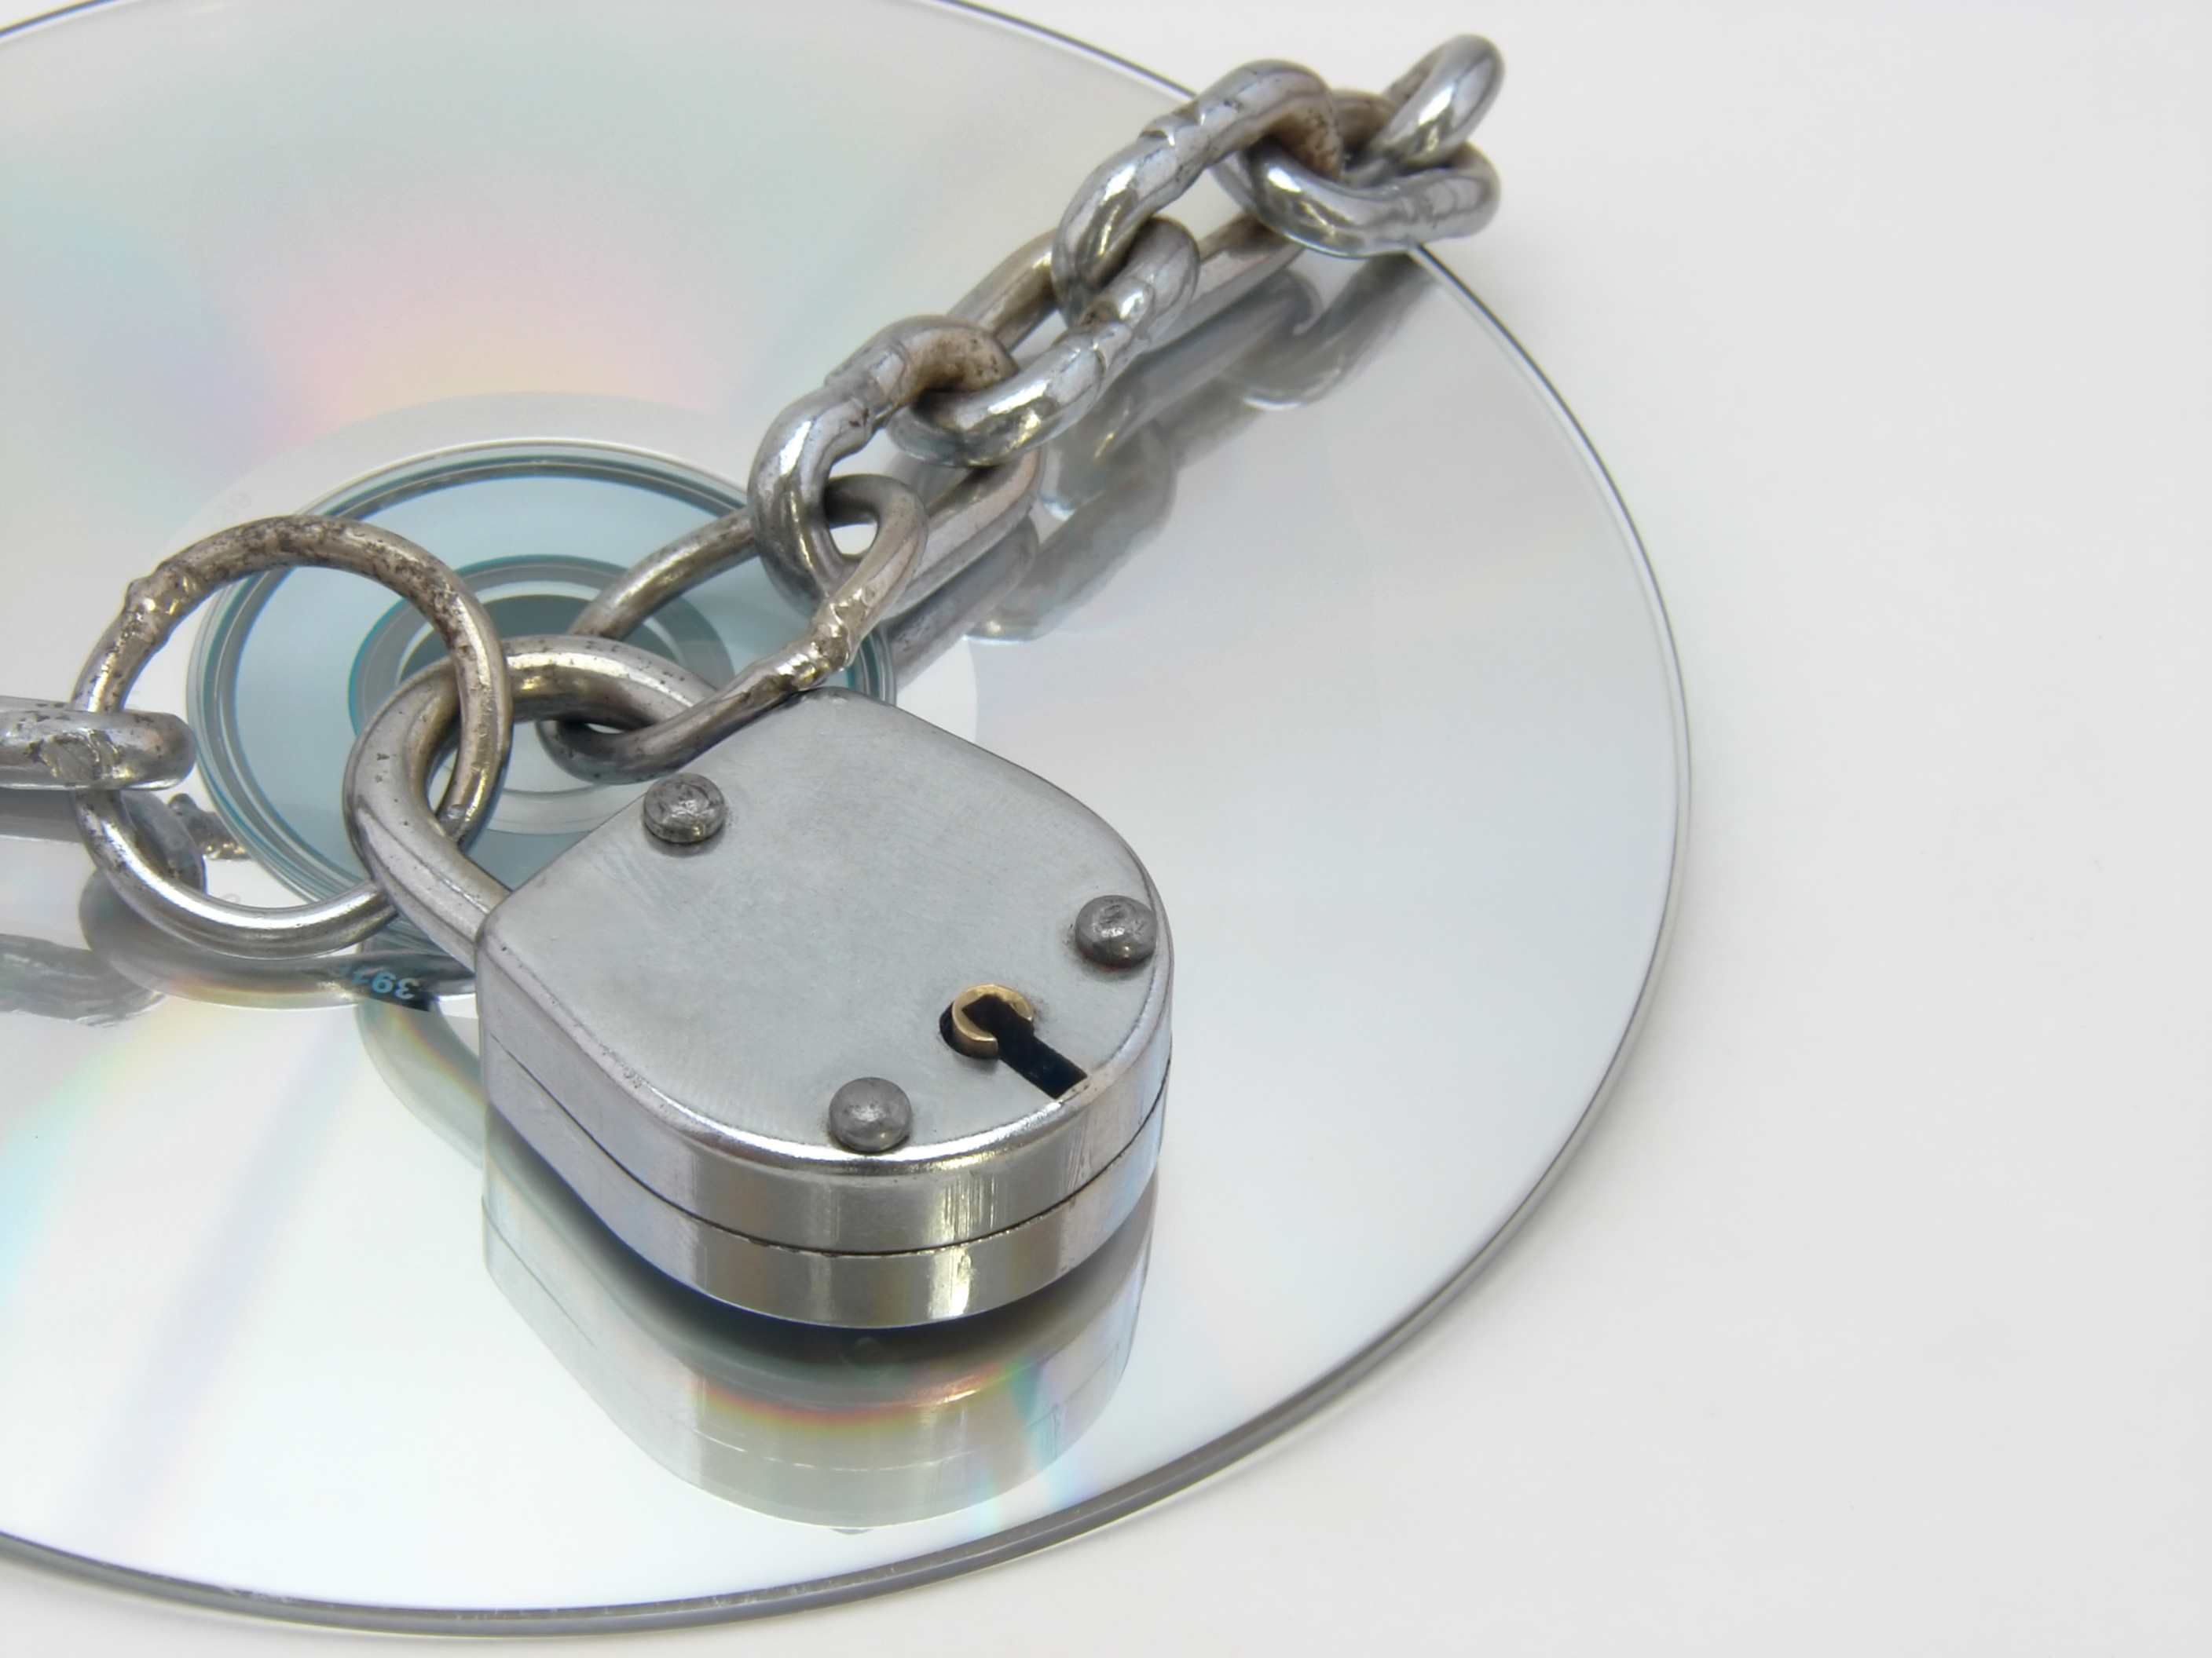
CCIS
Motivation
Cloud Computing and Intelligence Systems
The protection of digital resource copyrights has drawn extensive public concern in the past decade.
Traditional methods, however, fail to satisfy the requirements due to their poor timeliness, frequent infringement, and cumbersome in rights confirmation, etc.
2/21
Notes:
First is the motivation,
(1) The protection of digital resource copyrights has drawn extensive public concern in the past decade;
(2) Traditional methods, however, fail to satisfy the requirements due to their poor timeliness, frequent infringement, and cumbersome in resource rights confirmation, etc.

Slide 3
CCIS
What are smart contracts?
Cloud Computing and Intelligence Systems
Smart contracts are lines of code that are stored on a blockchain and automatically execute when predetermined terms and conditions are satisfied.
Blockchain is a shared, distributed ledger on which transactions are digitally recorded and linked together so that they provide the entire history or provenance of an asset.
3/21
Notes:
So, what are smart contracts?
(1) Smart contracts are lines of code that are stored on a blockchain and automatically execute when predetermined terms and conditions are satisfied;
and (2) Blockchain is a shared, distributed ledger on which transactions are digitally recorded and linked together so that they provide the entire history or provenance of an asset.

Slide 4
CCIS
Cloud Computing and Intelligence Systems
01
02
Digital Resource Confirmation
Infringement Tracking
Ownership
Usufruct
Rights Transfer chain
Digital watermark
4/21
Notes:
In our work, we focused on two typical tasks.
One is digital resource rights confirmation for ownership and usufruct.
Ownership namely is the copyright of a resource, while usufruct refers that you can scan or download a resource but cannot send it to others arbitrarily.
Another task is infringement tracking, we combine the rights transfer chain and digital watermark to handle it.

Slide 5
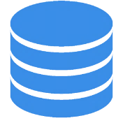
CCIS
Cloud Computing and Intelligence Systems
Digital Resource Platform D
Blockchain System
Digital Resource Platform A
Purchase other platform resources
A
I
Submit resource information to blockchain
B
C
smart
contract
smart
contract
H
D
smart
contract
G
E
F
Digital Resource Platform C
Digital Resource Platform B
Watermark System
Download resource
that user has purchased
Verify the user’s corresponding rights
Arnold Transform
Digital
watermark
The Architecture of Our Whole Proposed System
5/21
Notes:
This is the Architecture of Our Whole Proposed System, consisting of three components: blockchain system, watermark system, and digital resource platforms.

Slide 6



CCIS
Design Goals & Key Ideas
Cloud Computing and Intelligence Systems
Goal 1 Goal 2
Goal 3
Smart Contracts
Based Blockchain
Ownership and Usufruct
Digital Watermarking
High Efficiency
Applicability
Trackability
6/21
Notes:
The Design Goals and Key Ideas are high efficiency, applicability, and trackability.
So, we correspondingly utilize the smart contracts, divide the rights into ownership and usufruct, and introduce the digital watermarking.

Slide 7
CCIS
Cloud Computing and Intelligence Systems
01
Digital Resource Confirmation
7/21
Notes:
The first part: digital resource confirmation

Slide 8
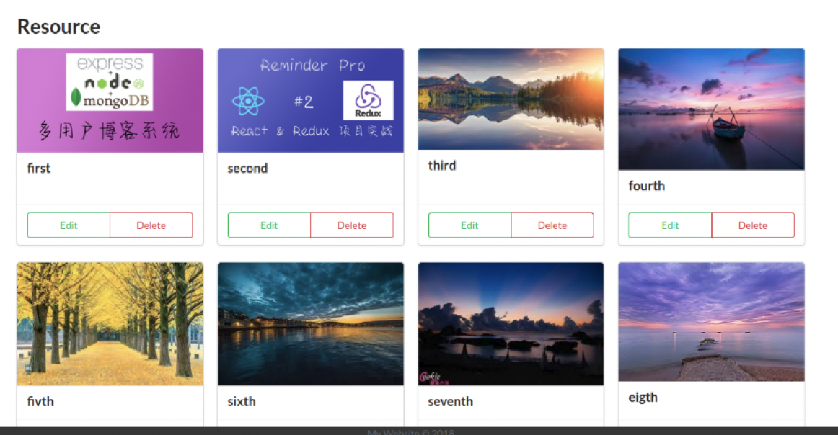
CCIS
Digital Resource Platform
Cloud Computing and Intelligence Systems
8/21
Notes:
In the resource platform, users can upload resource, scan resource, and trade ownership or usufruct of resource.
This is a simple figure description of a resource.

Slide 9
CCIS
Blockchain System
Cloud Computing and Intelligence Systems
Basic Resource;
User, Customer, Regulator;
Transactions;
BuyOwnershipTransaction,
CheckOwnershipTransaction;
…...
Everybody Can Read Everything;
…...
org.demo.network.cto
Logic.js
Permission.acl
Packaged
demo-network@0.0.1.bna
Deploy
Ordering
service
Client
Application
Hyperledger Fabric Network
ORG1 MSP
ORG2 MSP
World
State
txn
txn
…
Ledger
Peer0
Peer1
Peer0
Peer1
The Architecture of Blockchain System Based on Hyperledger Fabric and Composer
9/21
Notes:
Our blockchain system, based on Hyperledger fabric and composer, is built as a bridge so that resource platforms have access to achieve resource interoperability.
During the resource propagation, the blockchain system can call corresponding smart contracts to record changes of ownership and usufruct rights in real-time.

Slide 10
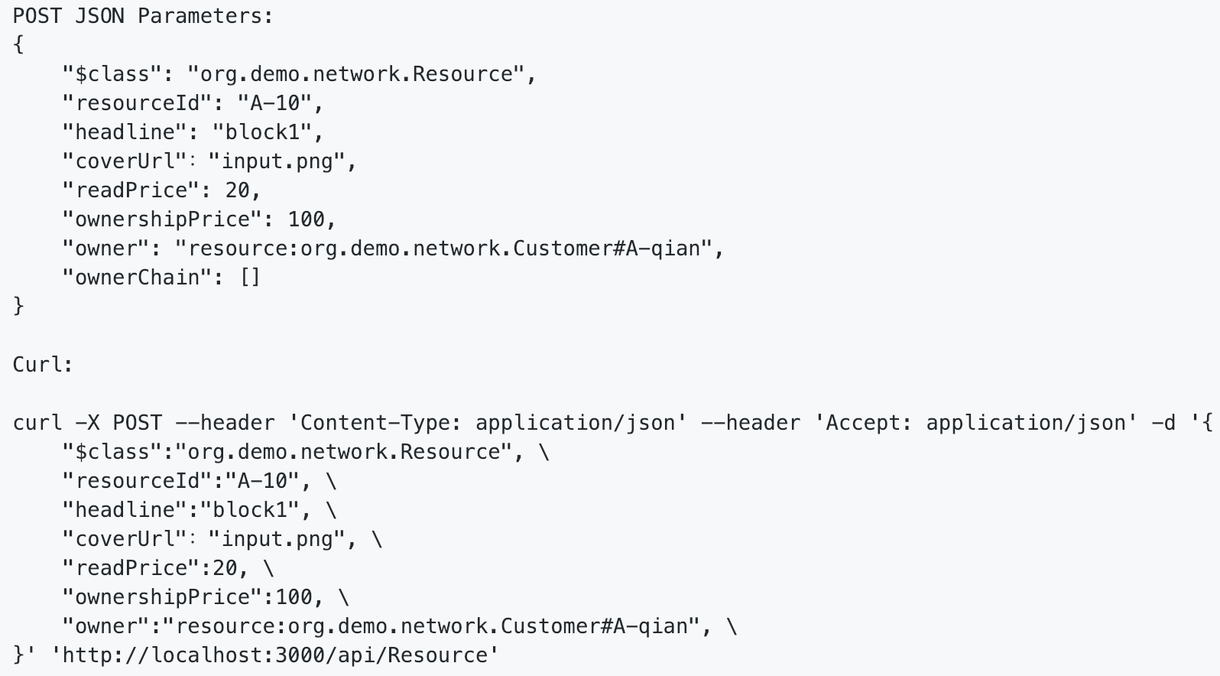
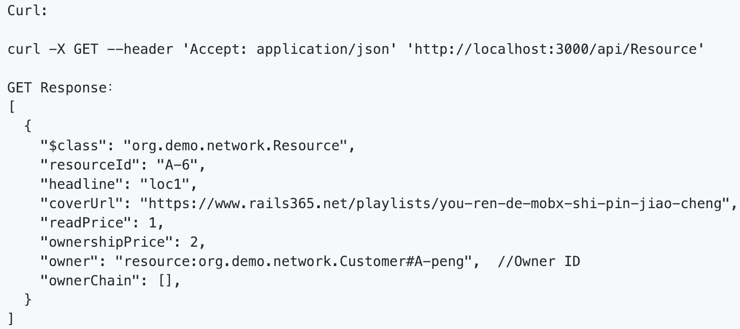
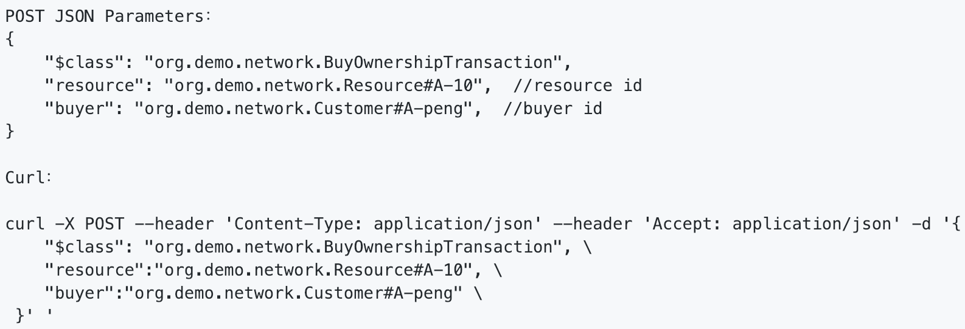
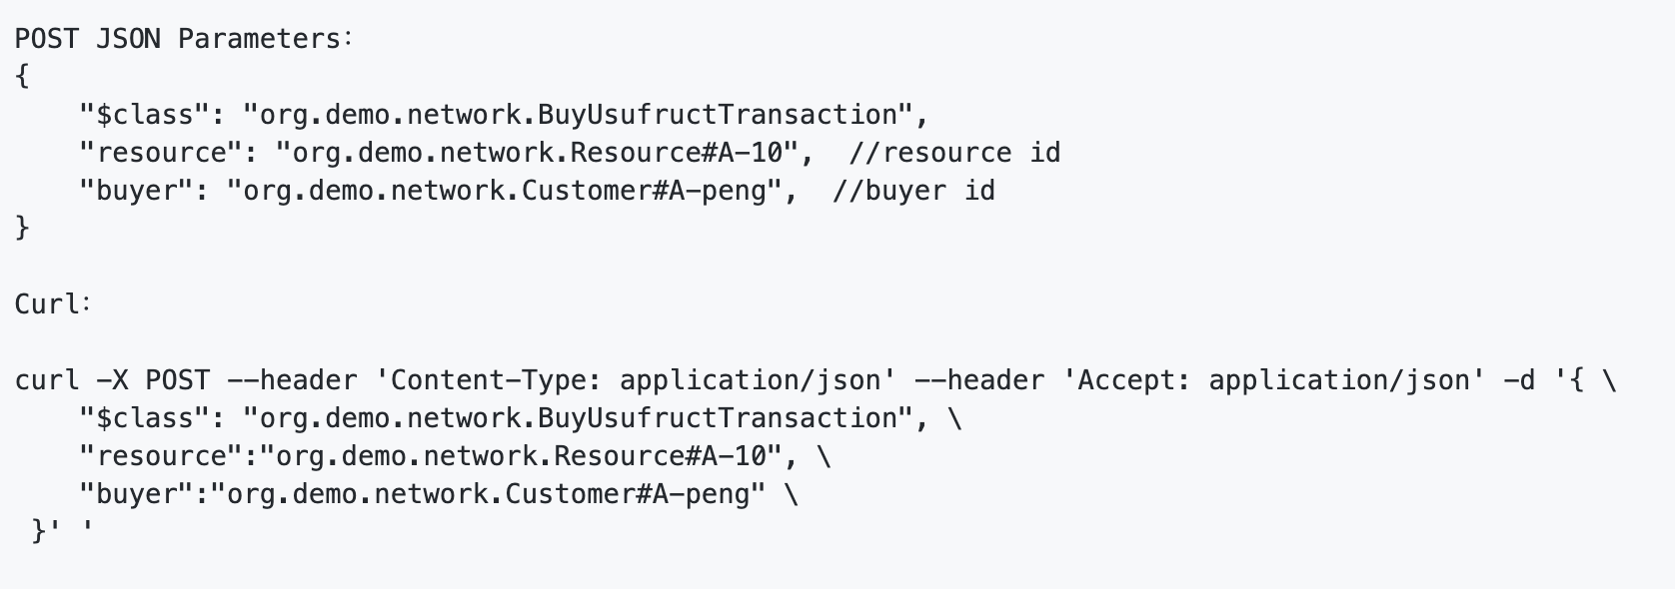



CCIS
Digital Resource Confirmation
Cloud Computing and Intelligence Systems
Digital resource platform
Blockchain system
Call Smart Contracts
Purchase ownership
A smart contract for ownership or usufruct confirmation.
A smart contract for resource information submission and display to the blockchain.
A smart contract for corresponding rights validation.
Purchase usufruct
Submit Information
Smart Contracts
Submit resources
Purchase Ownership
Display information
Display resource info
Watermark
Purchase Usufruct
Digital
resource
Watermark module
Submit information to blockchain
Arnold Transform
Digital watermark
Achieve resource right transaction
Verify user corresponding rights
Submit information to blockchain
Watermark
Information
Generate
Transfer
chain
Infringement tracking center
10/21
Notes:
Further, as the figure shows, we can submit resource information, realize rights confirmation, and verify rights by calling corresponding smart contracts deployed on the blockchain system.
Here, we present some specific request API operations, submission, display, purchase ownership and usufruct.

Slide 11
CCIS
Cloud Computing and Intelligence Systems
Infringement Tracking
02
11/21
Notes:
The second part: infringement tracking

Slide 12



CCIS
Watermark System
Cloud Computing and Intelligence Systems
Watermark Embedding and Extracting
Arnold Transform
Original Information
Sha-256
Inverse
Arnold
Embed
Watermark Information
Watermark
Matching
Arnold
Transform
Extract
Watermark Information
12/21
Notes:
In the watermark system, it offers the services of watermark embedding and extracting.
Here, we used the technique of Arnold transform, which is the process of scrambling pixel points in an image matrix that can enhance the security of watermark.
And, in our work, we use watermark algorithms containing LSB and DCT.

Slide 13

CCIS
Watermark System
Cloud Computing and Intelligence Systems
Assembling Watermark Information
Owner ID
Resource ID
Watermark Information
User ID
13/21
Notes:
The watermark system can be activated to achieve tracking by extracting the watermark information when an infringement occurs.
The watermark information actually includes the current owner ID, current user ID, and resource ID.

Slide 14
CCIS
Infringement Tracking
Cloud Computing and Intelligence Systems
Digital resource platform
A digital watermark is embed into a resource when submitted.
Extract watermark containing IDs of the owner, current user, and resource.
Combined with the generated transfer chain to confirm the leaker and owner precisely.
Blockchain system
Call Smart Contracts
Purchase ownership
Purchase usufruct
Smart Contracts
Submit resources
Display resource info
Watermark
Digital
resource
Watermark module
Submit information to blockchain
Arnold Transform
Digital watermark
Achieve resource right transaction
Verify user corresponding rights
Submit information to blockchain
Watermark
Information
Generate
Transfer
chain
Infringement tracking center
14/21
Notes:
Specifically, the processes of infringement tracking have two parts:
(1) extract watermark information from the infringed resource to confirm the leaker and original owner;
(2) retrieve transaction records to obtain the entire rights transfer chain from the time of resource released to the time of the resource leaked.
Combined with them, we can accurately and effectively identify the infringing source, which is conducive to deal with infringement disputes.

Slide 15




CCIS
Limitations and Solutions
Cloud Computing and Intelligence Systems
Cross platform
Applicability
Real time
Trackability
Blockchain with watermark
Traditional
Scheme
15/21
Notes:
For this part, we make some comparisons in terms of four factors, cross-platform, applicability, real-time, and trackability.

Slide 16

CCIS
Limitations and Solutions
Cloud Computing and Intelligence Systems
Cross platform
Applicability
Real time
Trackability
Blockchain with watermark
Digital Watermark based Scheme
16/21

Slide 17

CCIS
Limitations and Solutions
Cloud Computing and Intelligence Systems
Cross platform
Applicability
Real time
Trackability
Blockchain with watermark
Blockchain based Scheme
17/21

Slide 18
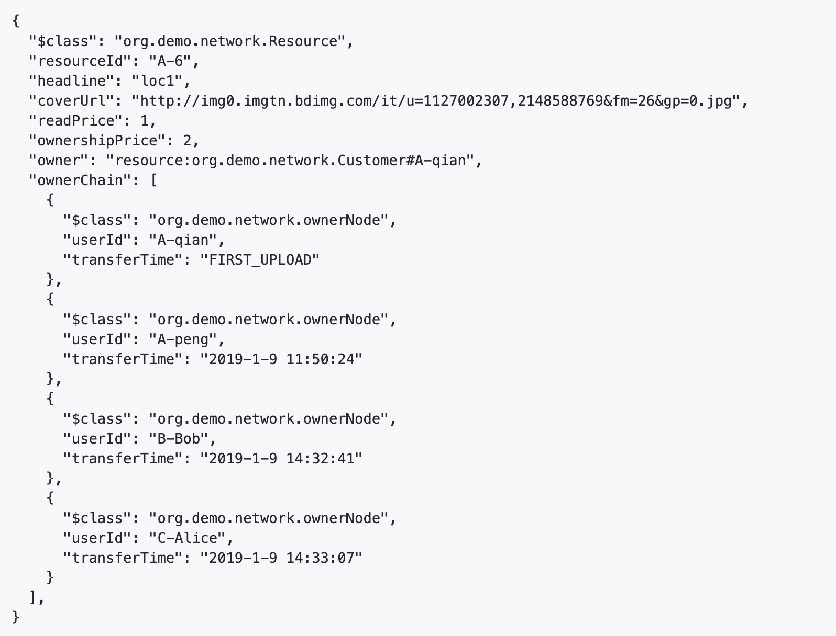

CCIS
Evaluations
Cloud Computing and Intelligence Systems
Timestamp
Ownership Transfer Chain
Ownership transfer chain
18/21
Notes:
Here, we show an example of an ownership transfer chain, which records the current owner of a resource.
Also, a specific process is extracted from our history records in the blockchain system.

Slide 19
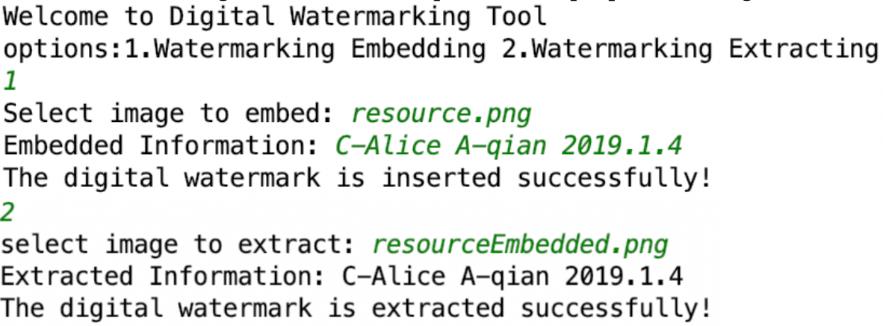
CCIS
Evaluations
Cloud Computing and Intelligence Systems
Owner ID + Current User ID + Resource ID
Watermark Demo
Original Image
Scrambled Image
Watermarked Image
The effect of digital watermark embedding
19/21
Notes:
There is the effect of digital watermark embedding and a demo of the watermark system.

Slide 20
CCIS
Conclusion
• Digital resource confirmation
We employ the Hyperledger Fabric to construct the basic blockchain system, designing smart contracts to achieve digital resource rights confirmation, including the ownership and usufruct.
• Infringement Tracking
We foster the study of using the digital watermarking combined with the rights transfer chain based on blockchain to realize infringement tracking.
Cloud Computing and Intelligence Systems
20/21

Slide 21

CCIS
Cloud Computing and Intelligence Systems
Thank you for listening!
21/21

